Slide 1
Lab 03 - Testing & Troubleshooting a Custom Connector 🚨

Slide 2
Agenda
Make Parameters dynamic
Testing in Power Automate
Testing in Power Apps
Testing with API Management / App Insights
Increase the Custom Connector usability

Slide 3
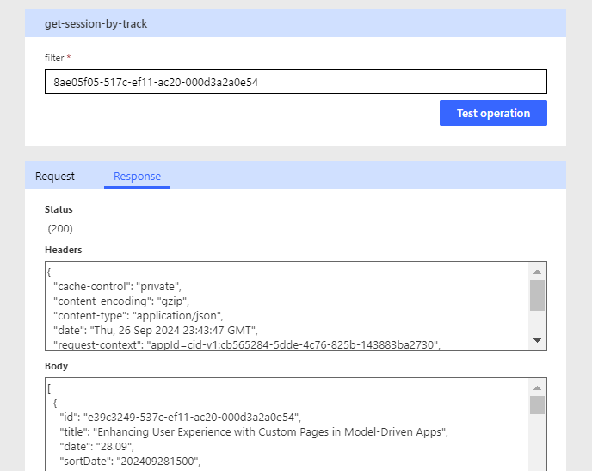
Different ways to test

Slide 4

DEMO TIME!
Notes:
Daniel Demo Visual Studio

Slide 5
Lab 03 – Testing and Troubleshooting a Custom Connector
Making and testing dynamic
Using the test pane in the custom connector UI
Testing a custom connector in Power Automate

Slide 7
Questions & Answers

Slide 8
Notes:
Please scan the QR code in the room to give feedback.
Room responsible will support us with a QR code – or use the App to find the session!

Slide 9
Session Feedback 2
Notes:
Please scan the QR code in the room to give feedback.
Room responsible will support us with a QR code – or use the App to find the session!

Slide 11
Thank You!

